Slide 1
NE 763: Advanced Reactor Materials
Fall 2026
Dr. Benjamin Beeler

Slide 2
Last Time
R-K models for molten salts and the MSTDB
Carbides fuel benefits:
  have high fissile density and high thermal conductivity
Two designs:
  He-bonded and Na-bonded designs for liquid metal or gas cooled reactors
Want hyperstoichiometric UC
  prevents metallic precipitates form forming/melting
  Two primary phases: UC and U2C3
Three stages in burnup that affect fuel temperature
  cracking on startup; free swelling (with potential densification); closed gap steady-state behavior

Slide 3
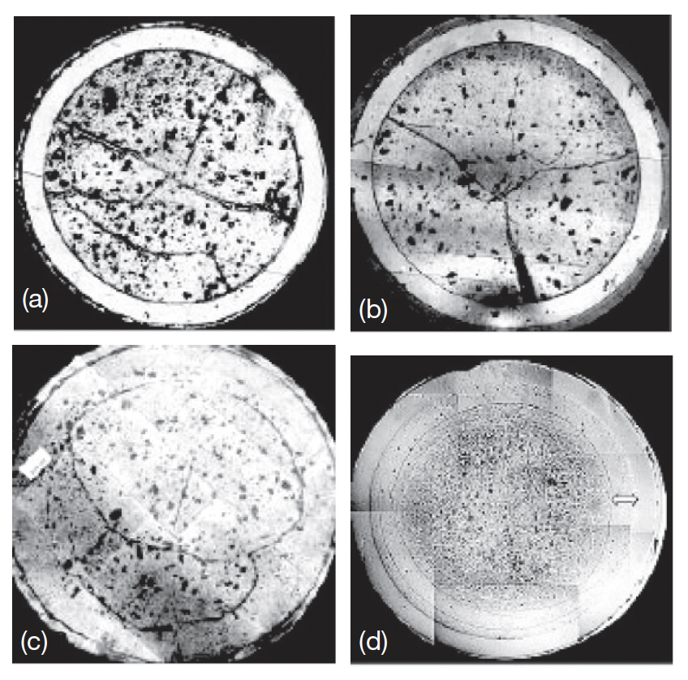
Evolution with Burnup
Carbide fuel containing 70% and 55% PuC was used as the driver fuel for FBTR
PIE at burnups of a) 2.5, b) 5, c) 10, and d) 15.5 at.% shows the evolution of the pin
After 10 at.% burnup, the gaps had closed at the center of the fuel column
Circumferential cracks due to thermal stresses formed, and a discrete zone free from any porosity is observed near the outer region at high BU

Slide 4
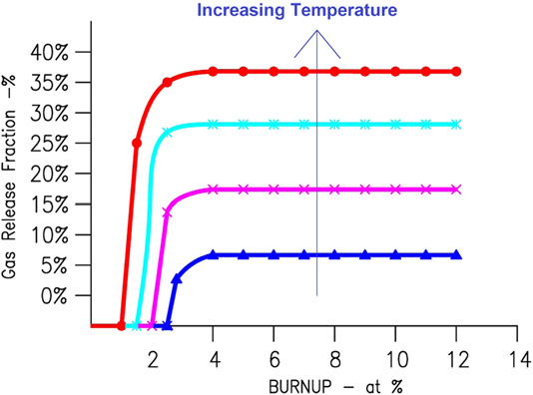
Fission Gas Release
FGR in carbide fuel pins is lower than oxide fuel pins, mainly due to lower temperatures
Release rates from carbide are <1% at temperatures below 900 C but rise to about 5%–10% with temperature rising to 1200 C
Above 1200 C, gas release is associated with bubble growth and interlinkage at grain boundaries, as in oxide fuels
Low density fuel releases more FG than high density, due to additional porosity and higher T
Off-stoichiometry also promotes porosity, and thus increases FGR

Slide 5
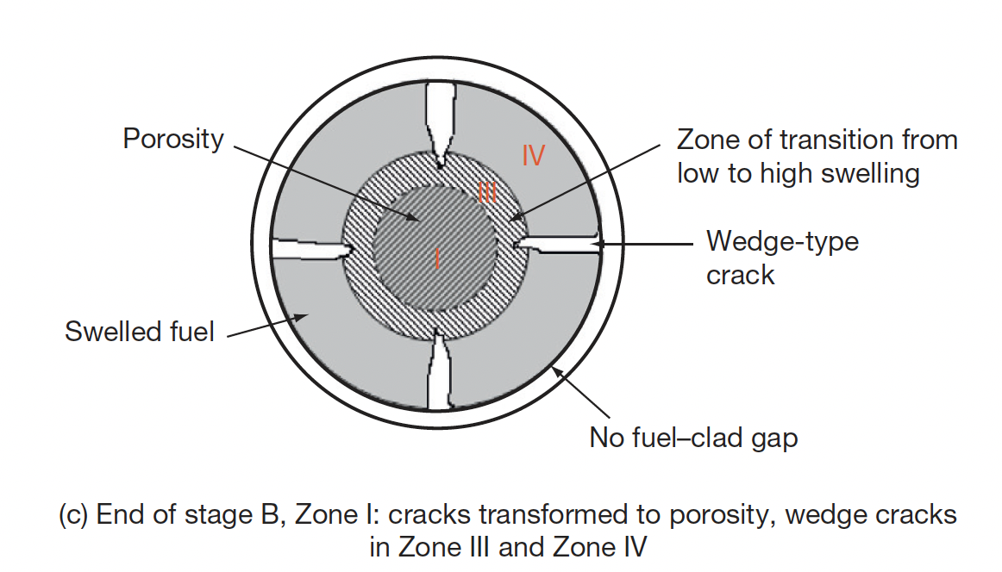
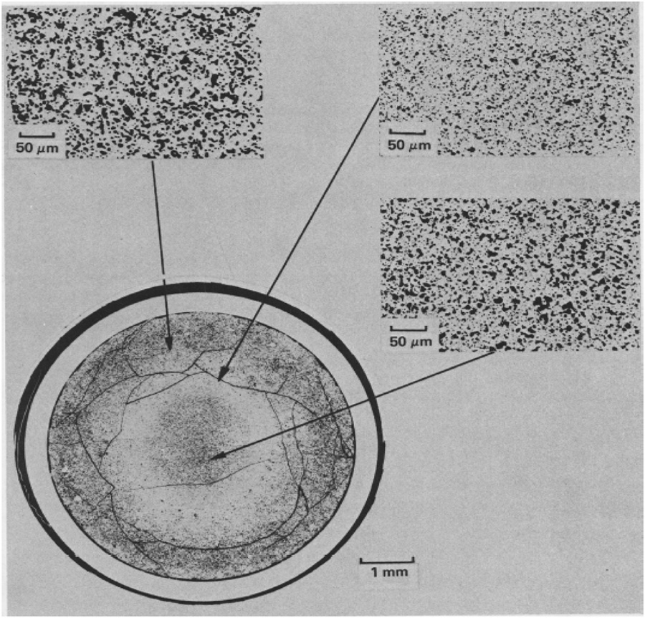
Fuel Restructuring
The cross section can be divided into four structural zones, becomes well defined when the fuel sees a burnup of 1.3 at.%.
Zone 1 is the porous fuel at the center having high temperature and leads to the release of fission gases
Zone 3 contributes to high microscopic swelling
Zone-IV is the coolest zone of the fuel cross section, which is next to the fuel cladding
Zone 2 is an intermediate zone that only exists at very high heating rate (>100 kW/m)

Slide 6
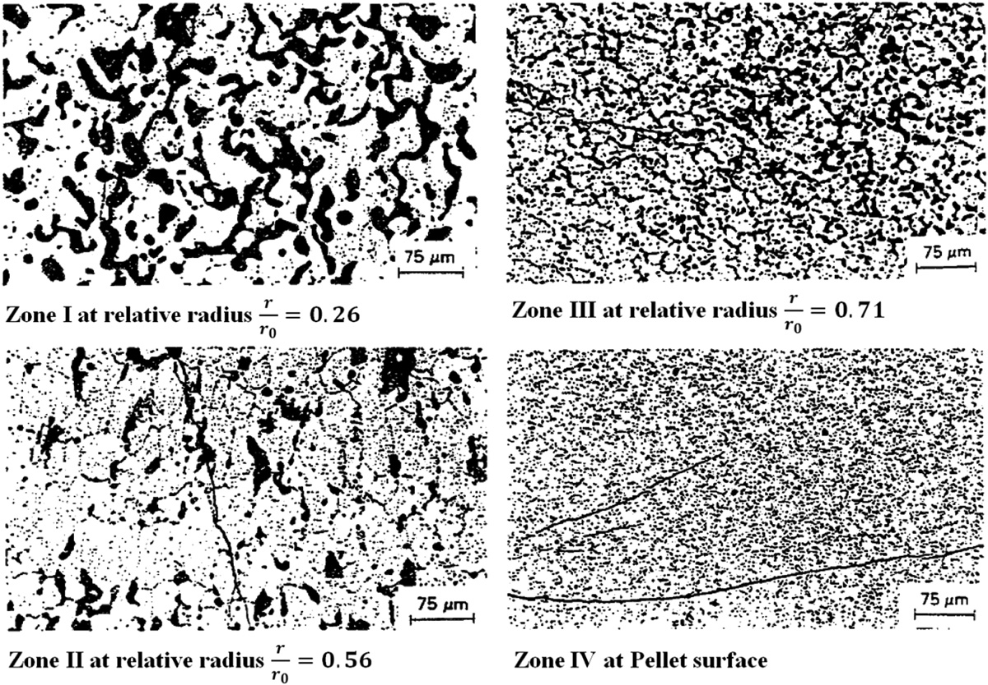
Fuel Restructuring
Zone 1 has large bubbles, interconnected porosity
Zone 2 exhibits grain growth parallel to the temperature gradient, somewhat similar to columnar grains in MOX fuel
Zone 3 has coaxial grain growth and developed porosity
Zone 4 typically has a stable grain size and near as-fabricated porosity
Zone 2 does not always form, expected to form at higher temperatures/power
At low LHR (<50 kW/m) no restructuring is observed

Slide 7

Fuel Creep
After the fuel–clad gap closure, free swelling is restrained, and a back stress is generated by the cladding on the fuel
The source of stresses in the fuel under irradiation is the pressure generated by fission gases produced within the fuel
Unlike close-packed metals, deformation of carbide requires much higher stresses because of the strong covalent bonding existing between the metal atom and the carbon atom
Two types of creep deformation are operative in the fuel: temperature-dependent thermal creep and irradiation creep
Thermal creep has been shown to start at 1000C and dominate over radiation-induced creep
The steady-state creep curve has been determined and is a function of stress, temperature, composition, grain size, and impurity content in the fuel

Slide 8
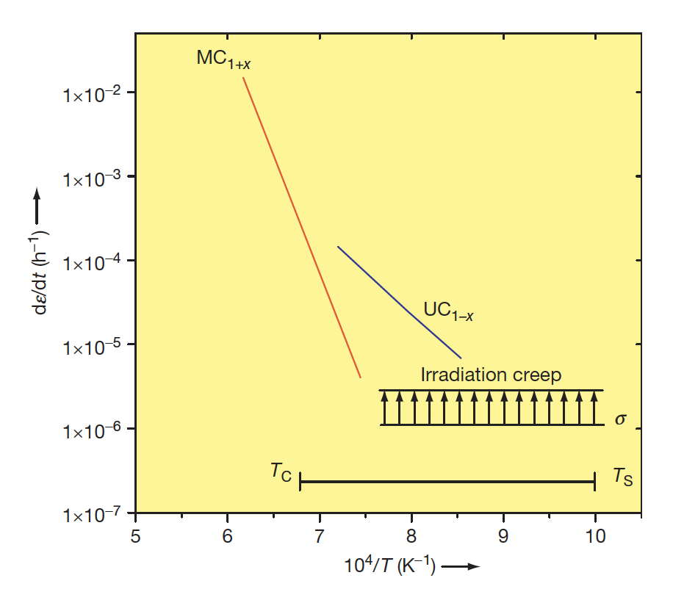
Fuel Creep
Steady-state creep data of UC_{1-x} and MC_{1+x} at a stress of 20 MPa
Substantial creep only exists for a limited part of the fuel, and thus most of the fuel acts as a brittle material
Irradiation-induced creep is independent of temperature, but increases with flux
Additional porosity or second phases will change this data
No data on creep of high-Pu mixed carbide or Pu-C fuel

Slide 9
Carbide FCCI
FCCI in fuel pins containing carbide fuel consists of clad carburization, slight reaction with FPs, and formation of intermetallic compounds
Carbides generally present fewer compatibility problems than MOX fuels
Chemical Reactions with FPs
Very little available oxygen leads to FP-C interactions, and we have an expected decrease in C/M ratio with burnup
Significant FP-cladding interactions are generally not seen
Some Te intergranular attack, some reaction with iodine
Generally not a concern

Slide 10
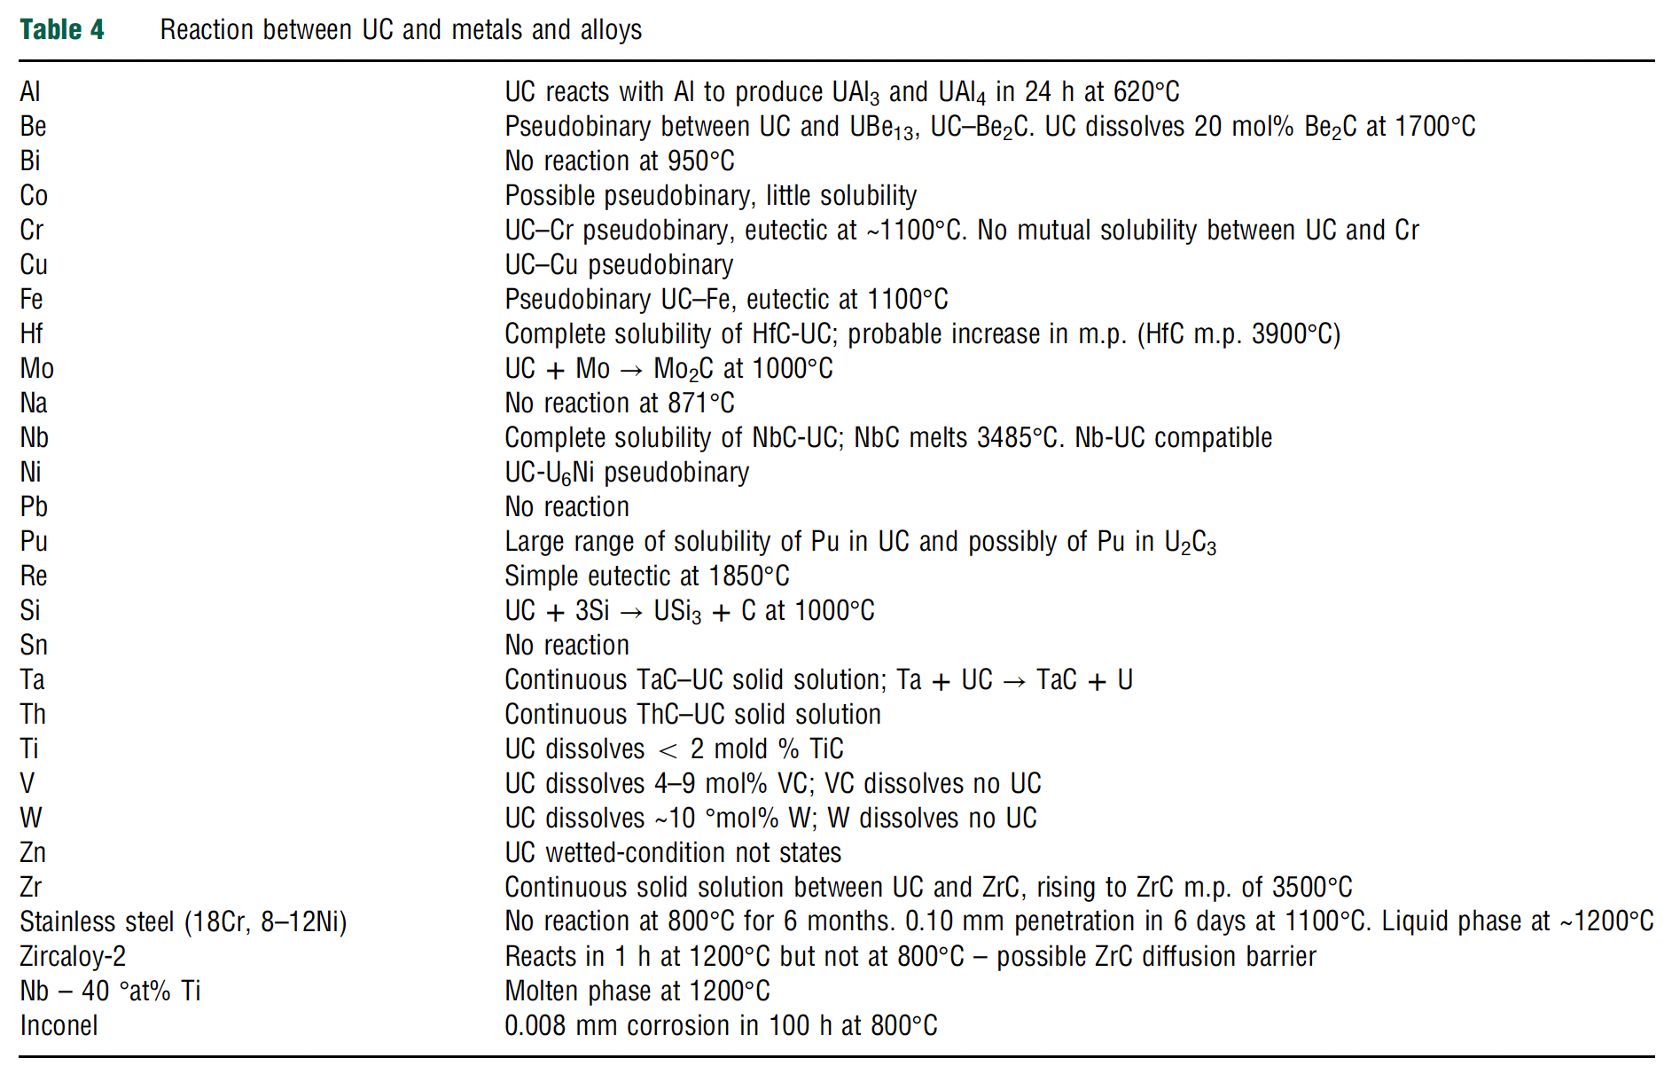
Carbide FCCI
Low melting phases
Hypostoichiometric carbide fuels can contain U/Pu metal as a second phase which can form intermetallic compounds with the cladding
Experimental compatibility tests of (U,Pu)C with cladding have shown intermetallic compounds such as (U,Pu)Fe2 or (U,Pu)Ni5 at the fuel/cladding interface
At typical fuel surface temperatures (~1000K), reaction rates should be slow to create intermetallics
However, if sufficient hypostoichiometry is present, can react to form intermetallics

Slide 11
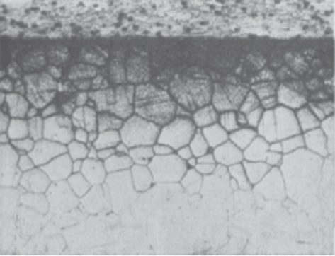
Cladding Carburization
Carbide fuels are designed to be hyperstoichiometric, which results in a two-phase UC/U2C3 microstructure
The presence of excess carbon prevents the formation of intermetallic phases, but carburizes the cladding
The decarburization of fuel and the carburization of cladding are governed by the dissolution of carbon atoms from the fuel and then diffusion into cladding
Cr forms very stable carbides, and carburization often takes the form of Cr23C6 precipitation

Slide 12
Cladding Carburization
Cr23C6 precipitation starts at the grain boundaries, and then can proceed along preferred crystallographic planes
The carburization proceeds deeper into the material
The grain boundary carbides can lead to intergranular failure of the steel after only a moderate burnup
Austenitic stainless steels are very susceptible to carburization and are deemed too brittle if carbon content reaches 0.6 wt.%
Regardless, Aust. SS are the main cladding material utilized in the FBTR

Slide 13
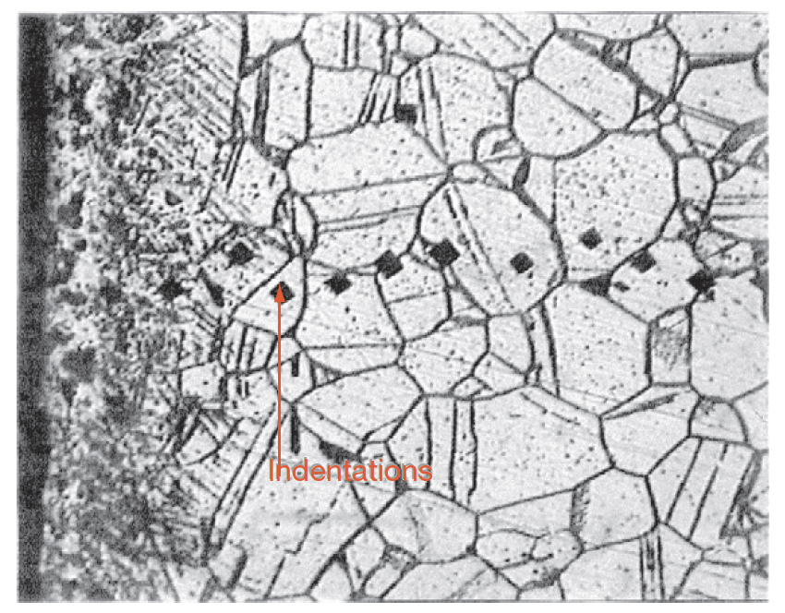
Cladding Carburization
Carbon activity and partial pressure of CO are important parameters responsible for clad carburization
In sodium-bonded fuel, carbon transfer from the fuel to the cladding takes place by dissolution of carbon in liquid sodium
In He-bonded fuel pins, carbon transfer takes place through CO
Out-of-pile testing with Na-bonded fuel showed carburization above 1000 K, with hardening of the SS316 cladding up to 100 μm
The depth of carburization in Na-bonded fuel was greater than in the He-bonded pins

Slide 14
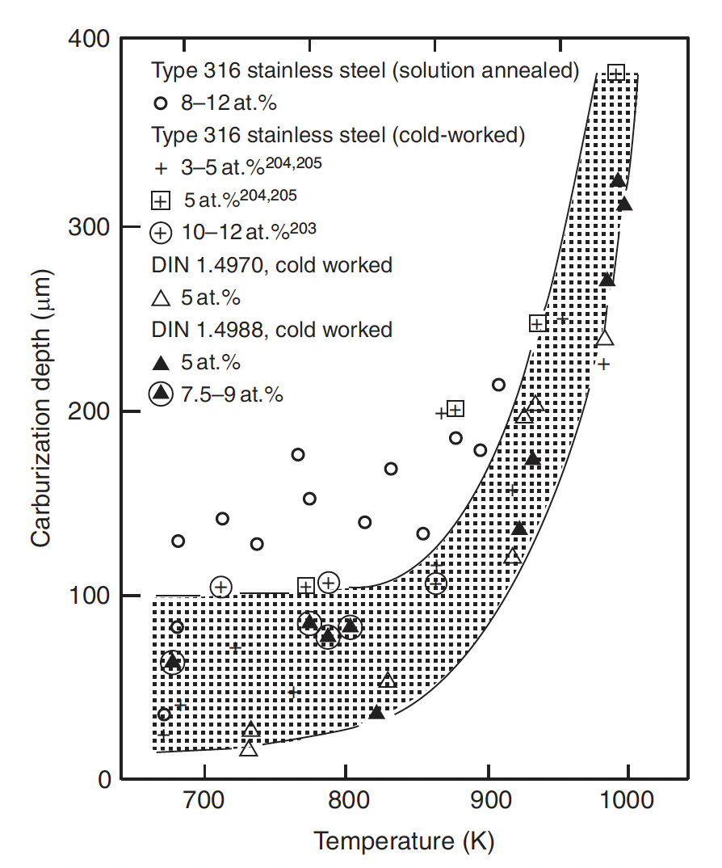
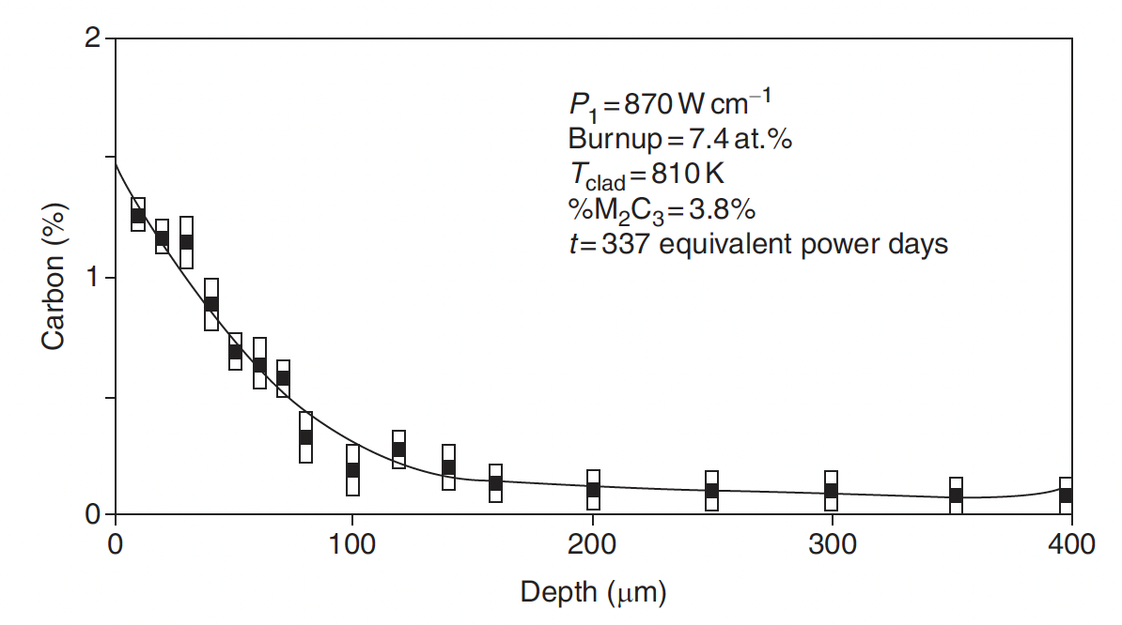
Cladding Carburization
The temperature gradient in the fuel causes carbon to migrate to colder zones in the fuel, increasing the C/M ratio at the pellet surface
Cladding temperature plays a critical role in carburization
Carburization depth shows a strong dependence on cladding temperature
Carbon penetration seems to follow a diffusion process with a constant surface concentration

Slide 15
Na Bonded Pin Performance
For the sodium-bonded fuel pin, the gap is larger than that of He-bonded fuel and the pellet density is higher
Thus, we have the manufacture of a denser fuel with less initial porosity
In the beginning (stage A), the fresh fuel fractures, reducing thermoelastic stresses and drastically changing temperature gradient of the fuel
There is a less abrupt change in fuel temperature in this concept
The lower temperature of the sodium-bonded pin keeps the swelling rate of the fuel lower
The decrease in thermal conductivity with burnup is compensated by a slow decrease in linear heating
FCMI can be avoided till end of life by proper selection of initial fuel–clad gap
Na bond acts like a medium for transfer of carbon from the fuel to clad, causing clad carburization

Slide 16
He Bonded Pin Performance
He bonding is the most preferred bonding concept of carbide fuel, due to cost and the potential for Na bond deterioration at high burnup
The in-pile performance of the He-bonded pin depends to a large extent on the porosity of the as-fabricated fuel
The initial temperature rise is much higher at the beginning of life because of the lower thermal conductivity of the He bond compared to Na bond
The lower thermal conductivity of the He bond requires the reduction of the fuel–clad gap compared to the Na-bonded fuel
The fuel density for He bonded fuel is lower and has a fabrication porosity of about 15%
The gap closure in the early burnup period results in lowering of the fuel temperature, and free swelling changes into restrained swelling under the contact pressure developed at the clad–fuel interface

Slide 17
Pin Failure
The mechanical properties of the fuel and clad (creep, fracture toughness) largely predict the fuel behavior after gap closure
Cladding breaches due to FCMI or FCCI can be due to loss of ductility of the clad, carburization of the clad, or fuel swelling
Clad carburization makes the clad surface hard and brittle and cracks form and propagate easily
It has been observed that the He-bonded pin can be operated safely up to 15 at.% burnup (peak burnup 20 at.%).

Slide 18
Carbide Fabrication
Fabrication of carbide fuel on commercial scale is a difficult task and needs additional care because of its pyrophoricity, high radio toxicity, and the concern for criticality restricts the batch size
Carbide powders formed during carbothermic reduction of oxides are prone to oxidation and hydrolysis
This requires high-purity inert-gas cover in the fabrication line consisting of glove boxes

Slide 19

Fabrication Techniques
Melting casting
In this method, UO2 or U metal chips with graphite are arc-melted and made into the form of a button
Melting casting route results in large-grained materials compared to that obtained by powder metallurgical methods
The melting casting method is, however, uneconomical due to the high cost of metal fabrication
Metal hydriding– dehydriding
This method is followed for small-scale production of high-purity carbides, where the metal hydride reacts with graphite
Actinide carbides MC and M2C3 can be prepared from a mixture of hydride and graphite
For UC, the reaction between uranium metal and a hydrocarbon gas (methane) is carried out with careful control of the hydrocarbon flow

Slide 20
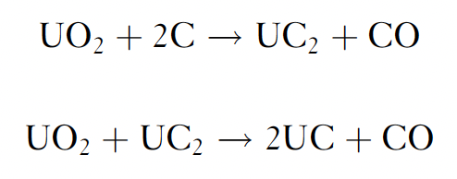
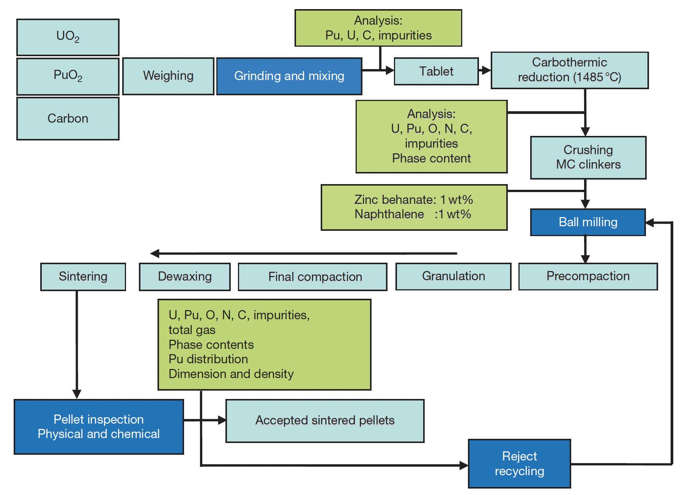
Carbothermic Reduction
Uranium monocarbide is mainly produced by carbothermic reduction of UO2 and carbon following the reaction
A mixture of UO2 and carbon is blended together and the mixture is compacted at 300–600 MPa along with an organic binder
The pellets are heated in a vacuum induction furnace and ground to a powder for compaction

Slide 21
Carbothermic Reduction
Uranium–plutonium-mixed carbide is also prepared by carbothermic reduction of UO2–PuO2
The physical state and homogeneity of the mixture influences the reaction rate and the quality of the final product
The reaction is complicated by the uneven distribution of plutonium in the two carbide phases and the formation of CO2 and CO, especially in hyperstoichiometric feedstock
Pu can volatilize and evaporate, which needs to be controlled via increased CO partial pressure
Carbothermic reduction temperature also depends on the Pu content of the material

Slide 22
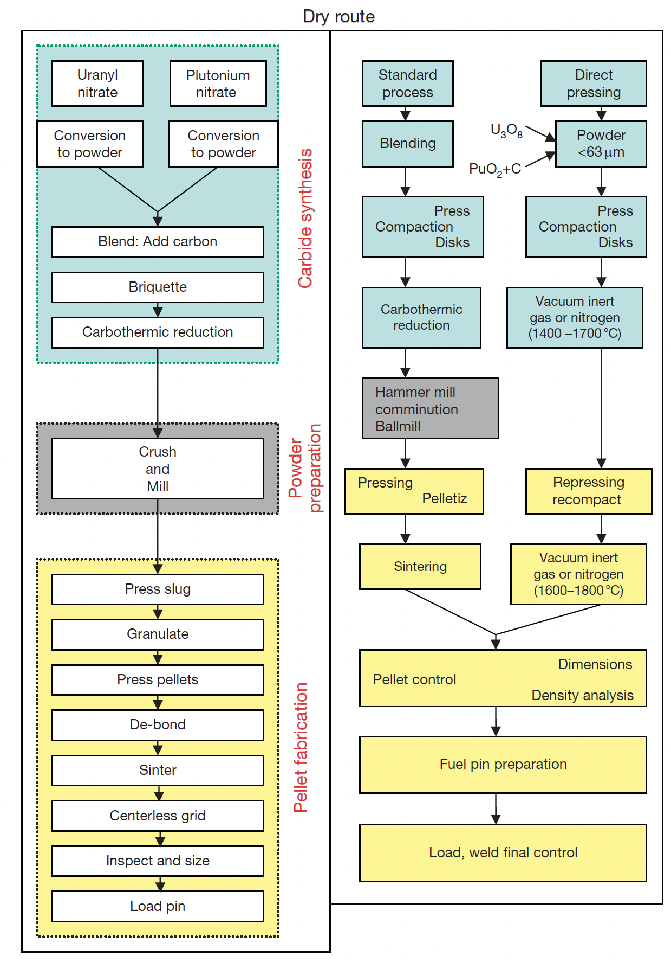
Pressing
The conventional powder metallurgy route of carbide fuel fabrication has certain disadvantages, including pick up of O/N impurities from the cover gas and risks of pyrophoricity
Direct pressing takes the product of carbothermic reduction and presses them into a low density pellet, which can be sintered into the final product
This reduces O pickup, reduces dust and impurities, and reduces time/cost
There is an additional route that involves wet processing of nitrate-based fuels in a sol-gel technique

Slide 23
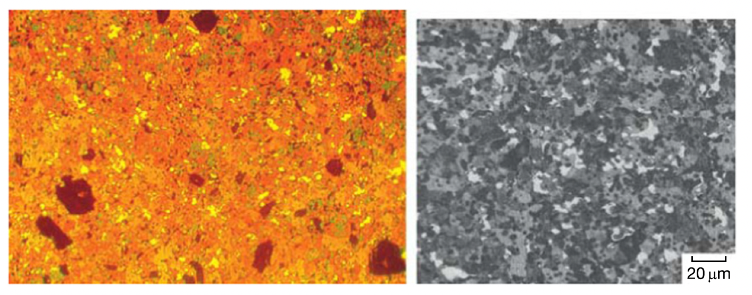
As-fabricated microstructures
Carbide pellets are susceptible to surface defects, such as chips and cracks
As in all sintered materials, residual porosity will be present
Varying degrees of the M2C3 phase will be present and are observable via characterization
Mixed carbide fuel with (a) 70%PuC and (b) 20%PuC showing bright/white areas of sesquicarbide phase

Slide 24
nitride fuels

Slide 25
Nitride Fuels
Nitride fuel has been proposed as an advanced fuel for fast reactors and developed since the 1960s and tested in the BR-10, MTR, and EBR-II reactors
Nitride fuel is often a solid solution of uranium mononitride (UN) and plutonium mononitride (PuN), in which the Pu/(U+Pu) molar ratio ranges from 0.15 to 0.25
Nitride has potential applications as a fuel for space reactors, large breeder reactors, different Gen IV fast reactors, accelerator-driven systems, and small modular reactors
UN is now also being considered as an accident tolerant fuel for LWRs

Slide 26
Nitride Fuel Benefits
Higher fissile density: 40% more uranium in UN than in UO2, leading to higher conversion ratios, and potentially higher burn-ups
Higher thermal conductivity: reduction of the fuel centerline temperature, increase in the margin for fuel melting, delay the migration of fission products and actinides
Reprocessing: readily dissolve in nitric acid (HNO3), making this fuel compatible with the PUREX process
Stability: chemically compatible with most potential cladding materials, good irradiation stability
Potential for longer fuel cycle: neutronic behavior of UN can extend cycles from 18 to 25 months, reducing costs and down time

Slide 27
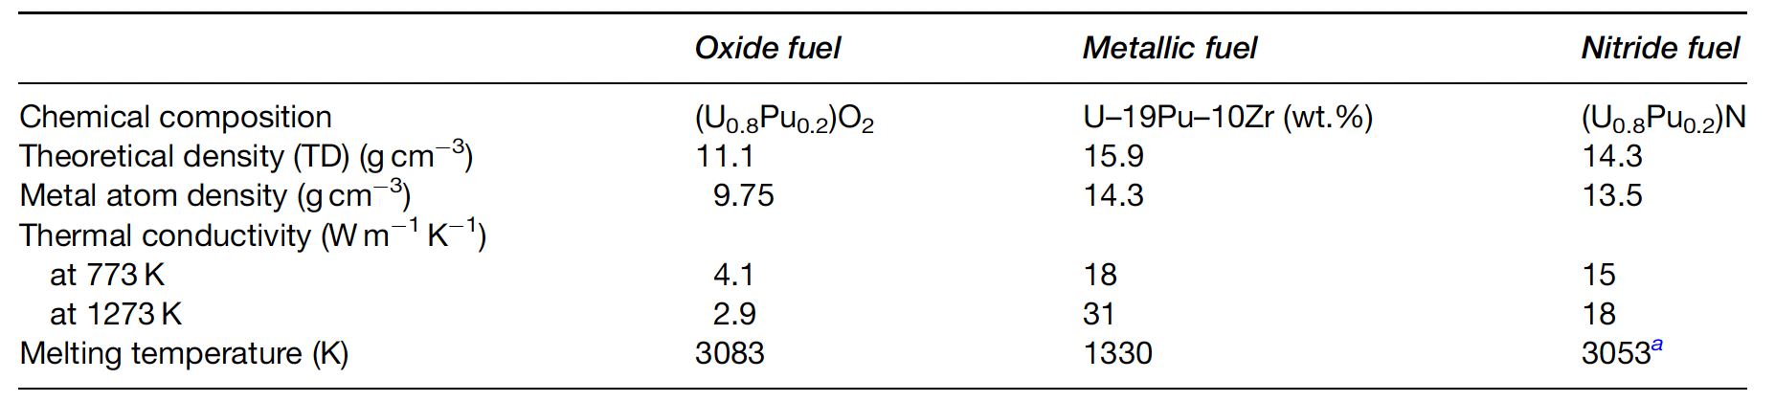
Nitride Properties
Best of both worlds fuel; with high melting point, high fissile density, and high thermal conductivity

Slide 28
Drawbacks of Nitrides
Fabrication: the production of MA or Pu-containing nitride fuel is not straight forward and requires some difficult production steps
Oxidation resistance: the nitride pellets readily oxidize in superheated steam
Nitride powder is pyrophoric, requiring strict atmospheric controls during fabrication and handling
Fuel enrichment: the nitrogen component has to be highly enriched in ¹⁵N to increase the neutron economy and avoid the (n, p) formation of ¹⁴C from ¹⁴N, which significantly increases costs
Fuel fabrication and N enrichment have led to slower development of MN fuels than MC fuels

Slide 29
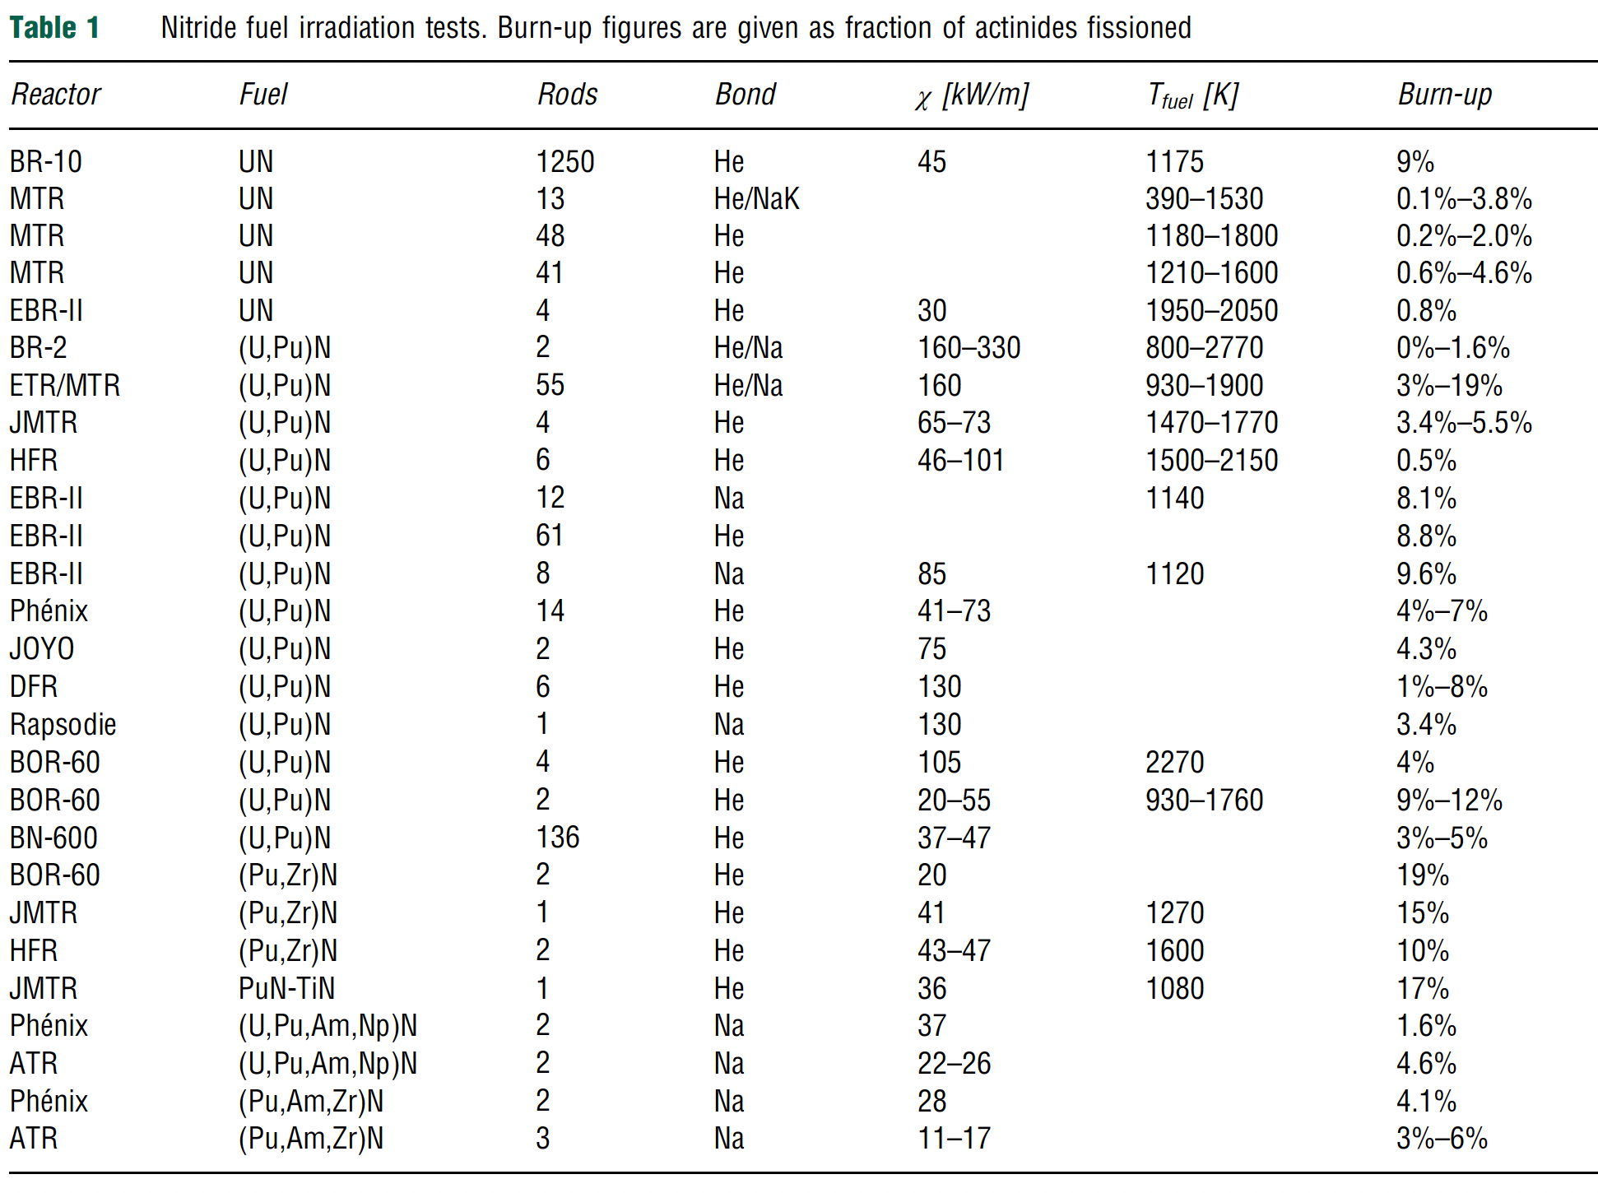
Irradiation History of Nitrides
The experience from irradiation of nitride fuels consists of about 1400 UN rods, 300 (U,Pu)N rods, and a few inert matrix and MA-bearing rodlets
UN was used as a driver fuel for BR-10 for 18 years, and this is where the majority of the irradiation data comes from
Similar to carbides, both Na-bonded and He-bonded pins have been studied, the majority being He

Slide 30
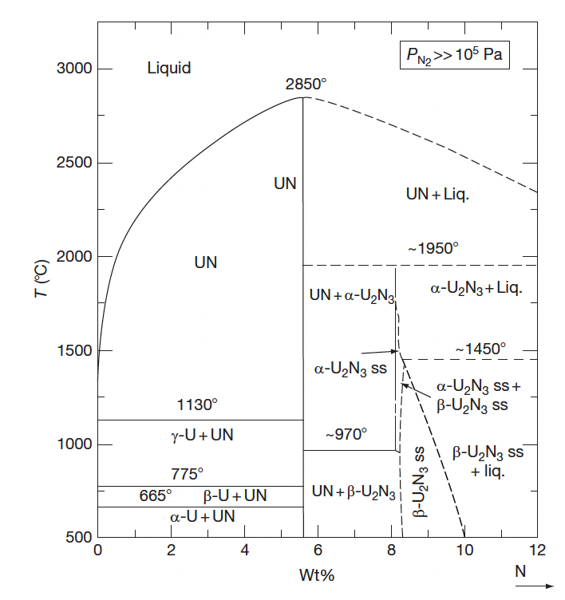
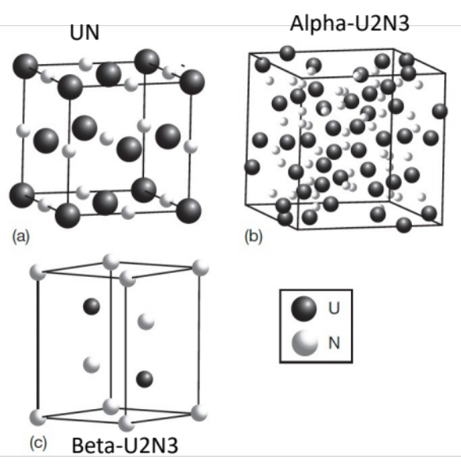
UN Phase Diagram
There are two main uranium nitrides, UN and U2N3; the former has an NaCl-type cubic structure, and the latter has an M2O3-type cubic structure at low temperature (alpha-U2N3) and a hexagonal structure at higher temperature (beta-U2N3)
The phase diagram of U–N is complicated since the diagram depends on nitrogen pressure
There is still uncertainty regarding the phase diagram

Slide 31
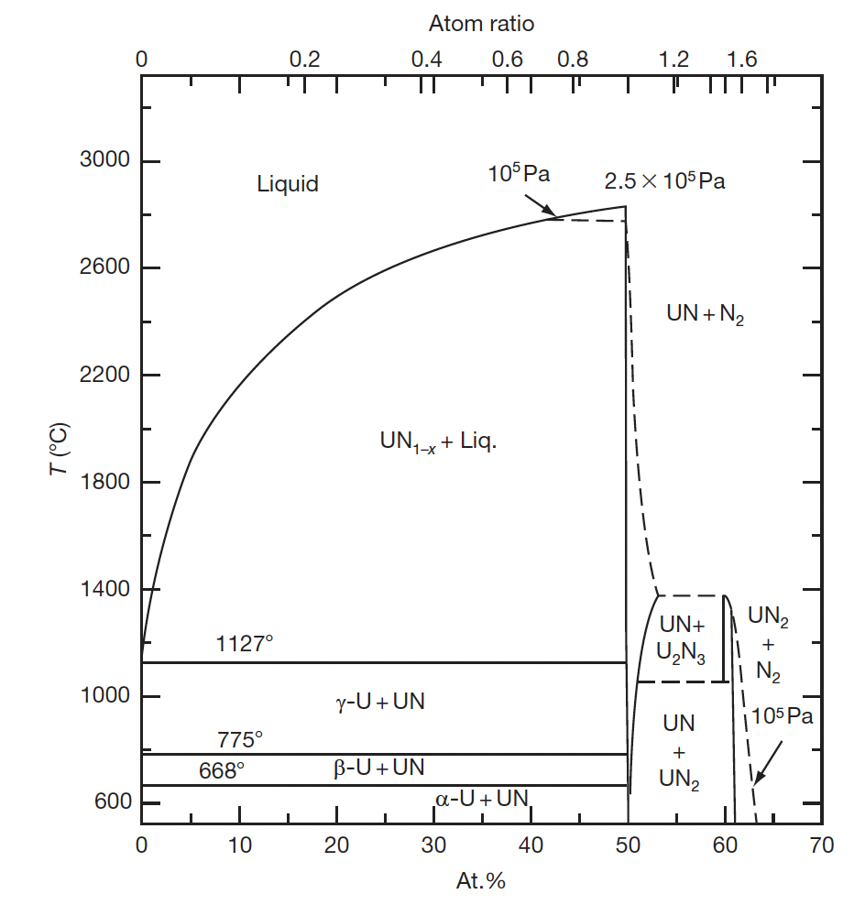
UN Phase Diagram
When nitrogen pressure is greater than 10⁵ Pa, UN melts at 3123K and that UN and U2N3 have a wide range of nonstoichiometry
At lower nitrogen pressure (<2E5 Pa) UN decomposes such that UN and U2N3 have little nonstoichiometry
At low P_{N}, the beta-U2N3 phase changes to UN2
U2N3 decomposes to UN, and UN decomposes to U and nitrogen at nitrogen pressure below 2.5 atm

